Slide 1
Explanation Dialogues for Understanding Foundation Model Behavior
Nils Feldhus German Research Center for Artificial Intelligence (DFKI), Berlin 2024-04-30
1st BIFOLD Tutorial Day @ Max Delbrück Center

Slide 2
Slide taken from Wallace et al. (2020) EMNLP Tutorial

Slide 3
Notable Failures of Neural NLP Models
Slide taken from Wallace et al. (2020) EMNLP Tutorial

Slide 4
Explanation Dialogues | Nils Feldhus

Slide 5
Explanation Dialogues | Nils Feldhus
Why do we need dialogue-based explanation?
Interactive conversational interface providing multi-turn dialogues and context
One-off explanations not sufficient, potentially ambiguous
Supporting various explanations in one single system
Ease of use; More accessible to laypeople
Notes:
Maybe add more images at each step?

Slide 6
Explanation Dialogues | Nils Feldhus
NLP Model Feature Attributions
Natural Language Counterfactuals
Rationale Generation with LLMs
Semantic Similarity
Interactive Dialogues with ML Models
The tweet includes insults related to body shaming.
Tweet: "blasey ford is a fat ugly lib​ral snowflake"
Explain in natural language,
Why is this text hateful?
Task:
Dialogue Act
Classification
...
Task:
Hate Speech Detection
Task:
Question
Answering

Slide 7
Explanation Dialogues | Nils Feldhus

Slide 8
Explanation Dialogues | Nils Feldhus
Free-text Rationale Generation
Task:
Conversational
Question Answering
(Multiple Choice​)
Explanations through Input Perturbation

Slide 9
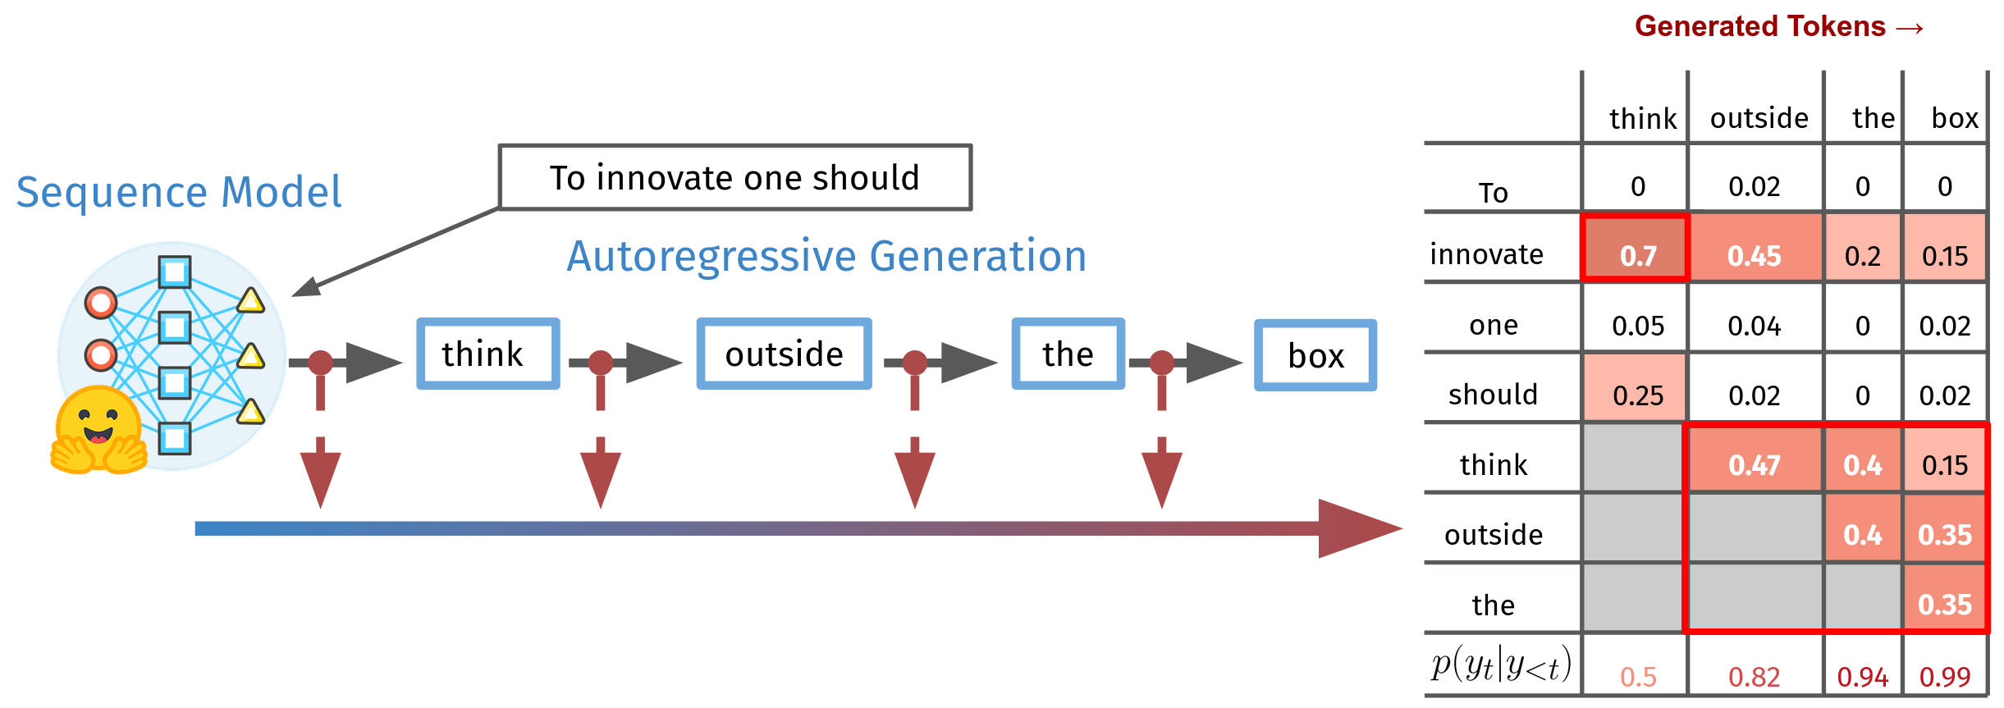
Explanation Dialogues | Nils Feldhus
Feature Attribution with
How do you complete the prompt "To innovate one should"? Please explain your reasoning!
Highlighted areas in the output show that the model relies on the keyword innovate to begin the idiomatic expression think outside the box at relatively low confidence (p = 0.5). However, importance shifts to previous tokens in the idiom throughout the generation.

Slide 10
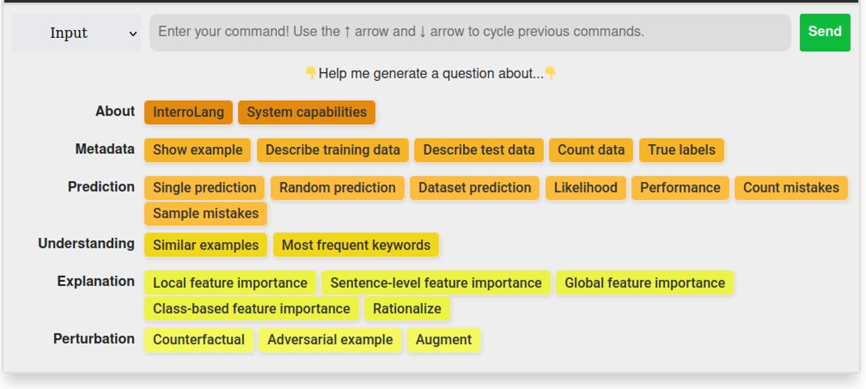
Explanation Operations
Explanation Dialogues | Nils Feldhus

Slide 11
Building blocks
Explanation Dialogues | Nils Feldhus
Operation | InterroLang
Intent recognition / Parsing
Feature Attribution / Saliency Method
Counterfactuals
Adversarial Examples
Data Augmentation
Rationalization
Similar Examples
Operation | InterroLang
Intent recognition / Parsing | GPT-Neo (2.7B) FLAN-T5-base (250M) BERT + Adapter (110M)
Feature Attribution / Saliency Method | Captum Integrated Gradients
Counterfactuals | Polyjuice (GPT-2)
Adversarial Examples | OpenAttack
Data Augmentation | NLPAug
Rationalization | Dolly v2 (3B)
Similar Examples | SBERT
Operation | InterroLang | LLMCheckup
Intent recognition / Parsing | GPT-Neo (2.7B) FLAN-T5-base (250M) BERT + Adapter (110M) | Llama2 (7B – 70B) Mistral (7B) Pythia, Falcon, …
Feature Attribution / Saliency Method | Captum Integrated Gradients | Inseq 11 saliency methods
Counterfactuals | Polyjuice (GPT-2) | Llama2 (7B – 70B) Mistral ​(7B)​​ Pythia, Falcon, …
Adversarial Examples | OpenAttack
Data Augmentation | NLPAug
Rationalization | Dolly v2 (3B)
Similar Examples | SBERT | SBERT

Slide 12
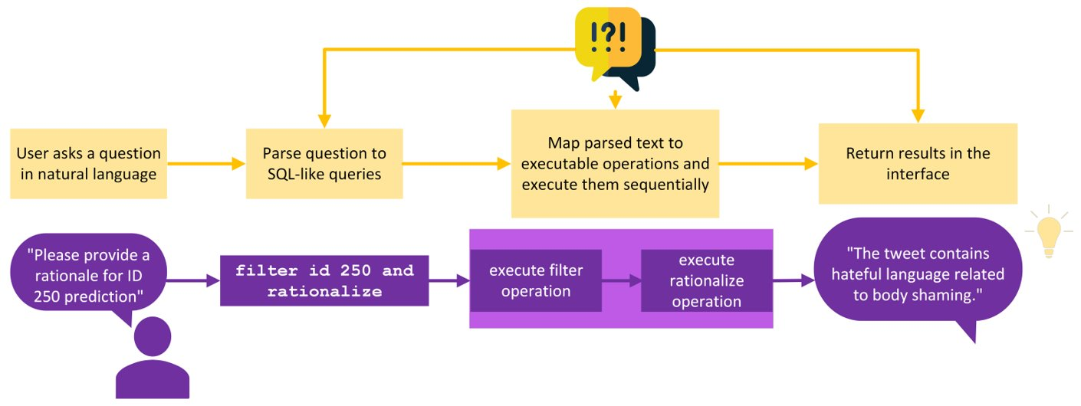
How to recognize user intent
Explanation Dialogues | Nils Feldhus

Slide 13
Experiments: Intent recognition Exact match accuracy for mapping user question onto explanation operation
Explanation Dialogues | Nils Feldhus

Slide 14
Intent recognition with LLMs Multi-prompt Parsing
Explanation Dialogues | Nils Feldhus
User question: What's the important feature for data point 33 according to LIME?
Predict all operations in their base format filter and nlpattribute 1️⃣ 2️⃣ 3️⃣
Additionally prompt the model to fill in parameters and attributes of functions filter id and nlpattribute topk 1 lime
​ ​ ​4️⃣​ ​​ ​ ​​ 5️⃣ 6️⃣

Slide 15
Overview of XAI Dialogue Systems

Slide 17
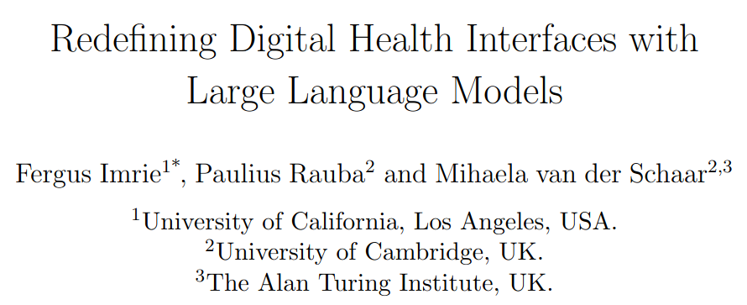
XAI Dialogues for Clinical/Medical Settings
Explanation Dialogues | Nils Feldhus

Slide 18
Explanation Dialogues | Nils Feldhus
XAI Dialogues for Video Streaming Quality-of-Experience Models

Slide 19
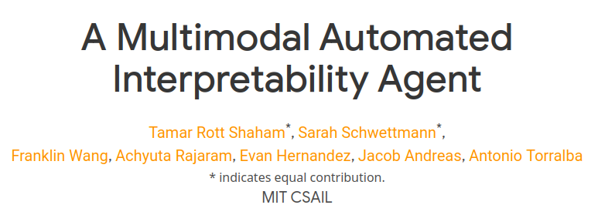
Explanation Dialogues | Nils Feldhus

Slide 20
Explanation Dialogues | Nils Feldhus

Slide 21
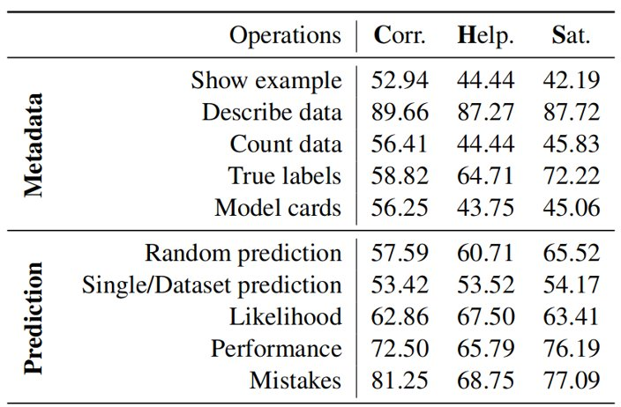
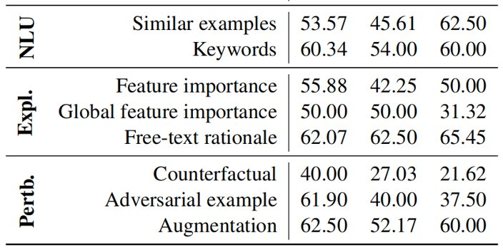
Human evaluation: Subjective ratings
Explanation Dialogues | Nils Feldhus
Subjective ratings (% positive) on correctness, helpfulness and satisfaction for single turns, macro-averaged.

Slide 22
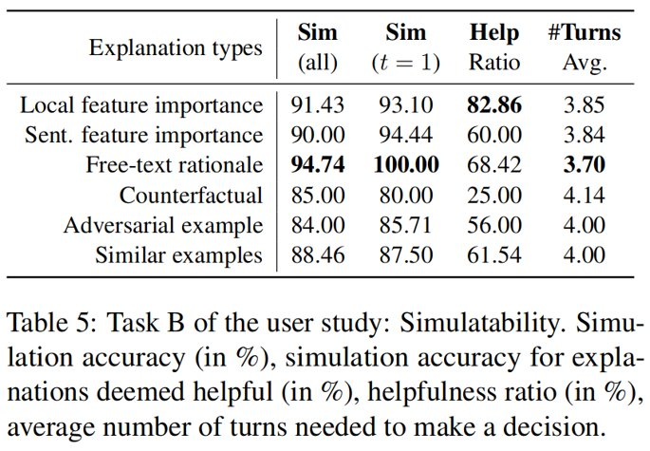
Human evaluation: Simulatability
Explanation Dialogues | Nils Feldhus
User is exposed to: Input + Explanation
User has to predict the expected model outcome
Simulation accuracy: How often user prediction == Actual model outcome

Slide 23
Takeaways for XAI Dialogues
Explanation Dialogues | Nils Feldhus
Multi-prompt Parsing and BERT + Adapter solutions work best for intent recognition
Human evaluators preferred global explanations and analyses
Tutorials (Meta-explanations on ML concepts)
Metadata (Model cards / Datasheets)
Common mistakes made by the model
Performance metrics (Accuracy, F1, etc.)
Simulatability shows multi-turn explanations are necessary. Most useful explanation types:
Feature attribution
Free-text rationales

Slide 24
Outlook
Explanation Dialogues | Nils Feldhus
Faithful response generation How can we make sure the LLM-generated responses are grounded in the data and accurately reflect its latent representations?
Conversational Model Alignment How can we use the user feedback (ratings and responses) to improve the model?
Actual implementations​ of XAI dialogue systems in other domains
InterroLang: Exploring NLP Models and Datasets through Dialogue-based Explanations
Feldhus et al.
Published in EMNLP 2023 Findings & BlackboxNLP.
LLMCheckup: Conversational Examination of Large Language Models via Interpretability Tools and Self-Explanations
Wang et al.
Accepted to NAACL 2024 HCI+NLP.

Slide 25
Thanks to my co-authors and colleagues!
Sebastian Möller
Qianli Wang
Robert Schwarzenberg
Leonhard Hennig
Maximilian D. Nasert
Christopher Ebert
Ajay M. Ravichandran
Philippe Thomas
Aleksandra Gabryszak
Jan Nehring
Aljoscha Burchardt
Roland Roller
Tim Polzehl
Stefan Hillmann
Lisa Raithel
Vera Schmitt
Nikolas Wehner
Tobias Hoßfeld
Gabriele Sarti
Ludwig Sickert
Malvina Nissim
Arianna Bisazza
Tatiana Anikina
Josef van Genabith
Sahil Chopra
Cennet Oguz
Mareike Hartmann
Oskar van der Wal

